Slide 1

WAKE UP

Slide 2
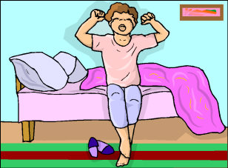
GET UP

Slide 3
WAKE UP

Slide 4
GET UP

Slide 5

TAKE A SHOWER

Slide 6
WAKE UP

Slide 7
GET UP

Slide 8
TAKE A SHOWER

Slide 9
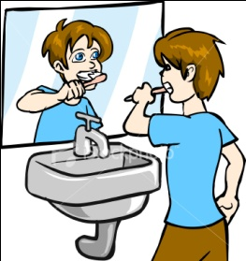
BRUSH MY TEETH

Slide 10
WAKE UP

Slide 11
GET UP

Slide 12
BRUSH MY TEETH

Slide 13
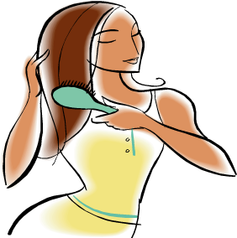
BRUSH MY HAIR

Slide 14
WAKE UP

Slide 15
GET UP

Slide 16
BRUSH MY HAIR

Slide 17
TAKE A SHOWER

Slide 18
BRUSH MY TEETH

Slide 19
BRUSH MY HAIR

Slide 20
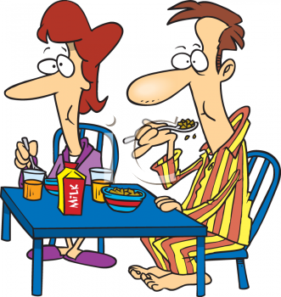
HAVE BREAKFAST

Slide 21
WAKE UP

Slide 22
GET UP

Slide 23
TAKE A SHOWER

Slide 24
HAVE BREAKFAST

Slide 25
BRUSH MY TEETH

Slide 26
HAVE BREAKFAST

Slide 27
BRUSH MY HAIR

Slide 28
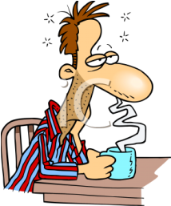
HAVE A COFFEE

Slide 29
HAVE BREAKFAST

Slide 30

GO TO WORK

Slide 31
WAKE UP

Slide 32
GO TO WORK

Slide 33
GET UP

Slide 34
HAVE A COFFEE

Slide 35
HAVE BREAKFAST

Slide 36
TAKE A SHOWER

Slide 37
HAVE A COFFEE

Slide 38
BRUSH MY TEETH

Slide 39
BRUSH MY HAIR

Slide 40
GO TO WORK

Slide 41
HAVE A COFFEE

Slide 42
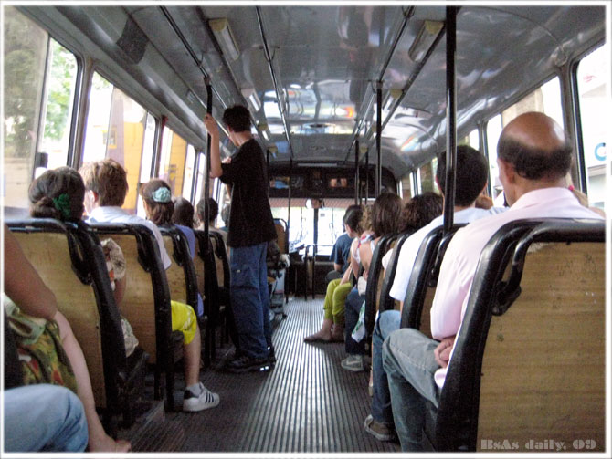
TAKE THE BUS

Slide 43

WORK

Slide 44
GO TO WORK

Slide 45
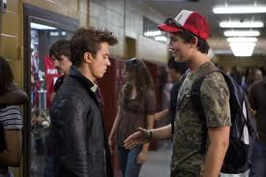
MEET FRIENDS

Slide 46
GO TO WORK

Slide 47
WAKE UP

Slide 48
GET UP

Slide 49
TAKE THE BUS

Slide 50
WORK

Slide 51
MEET FRIENDS

Slide 52
TAKE A SHOWER

Slide 53
MEET FRIENDS

Slide 54
BRUSH MY TEETH

Slide 55
GO TO WORK

Slide 56
TAKE THE BUS

Slide 57
BRUSH MY HAIR

Slide 58
HAVE A COFFEE

Slide 59
TAKE THE BUS

Slide 60
WORK

Slide 61

TALK

Slide 62
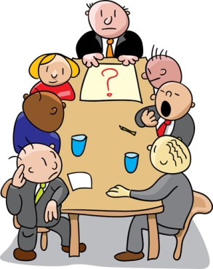
HAVE A MEETING

Slide 63
WORK

Slide 64
MEET FRIENDS

Slide 65
WAKE UP

Slide 66
GET UP

Slide 67
TALK

Slide 68
GO TO WORK

Slide 69
TAKE A SHOWER

Slide 70
MEET FRIENDS

Slide 71
BRUSH MY TEETH

Slide 72
BRUSH MY HAIR

Slide 73
TALK

Slide 74
HAVE A COFFEE

Slide 75
TALK

Slide 76
HAVE BREAKFAST

Slide 77
GO TO WORK

Slide 78
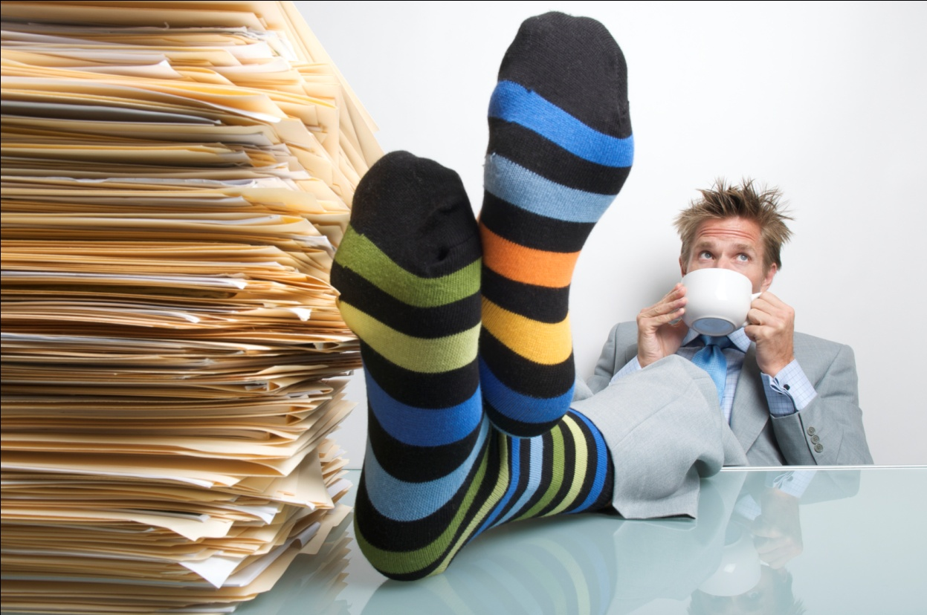
HAVE A BREAK

Slide 79
TALK

Slide 80
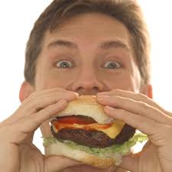
EAT

Slide 81
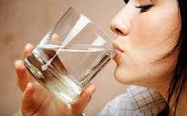
DRINK

Slide 82
WAKE UP

Slide 83
DRINK

Slide 84
EAT

Slide 85
DRINK

Slide 86
WORK

Slide 87
EAT

Slide 88
GET UP

Slide 89
EAT

Slide 90
HAVE A BREAK

Slide 91
TAKE A SHOWER

Slide 92
HAVE A BREAK

Slide 93
HAVE BREAKFAST

Slide 94
TAKE THE BUS

Slide 95
EAT

Slide 96
TALK

Slide 97
HAVE A BREAK

Slide 98
WORK

Slide 99
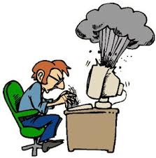
USE THE COMPUTER

Slide 100
GO TO WORK

Slide 101
DRINK

Slide 102
HAVE BREAKFAST

Slide 103
USE THE COMPUTER

Slide 104
DRINK

Slide 105
TALK

Slide 106
TAKE THE BUS

Slide 107
MEET FRIENDS

Slide 108
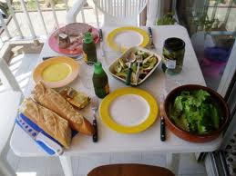
HAVE LUNCH

Slide 109
USE THE COMPUTER

Slide 110
HAVE BREAKFAST

Slide 111
USE THE COMPUTER

Slide 112
EAT

Slide 113
MEET FRIENDS

Slide 114
EAT

Slide 115
HAVE LUNCH

Slide 116
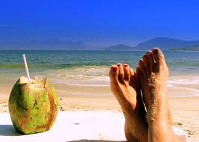
REST

Slide 117
HAVE LUNCH

Slide 118
HAVE A BREAK

Slide 119
WAKE UP

Slide 120
EAT

Slide 121
REST

Slide 122
USE THE COMPUTER

Slide 123
DRINK

Slide 124
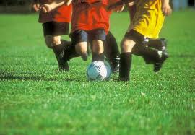
PLAY SOCCER

Slide 125
HAVE LUNCH

Slide 126
REST

Slide 127
USE THE COMPUTER

Slide 128
DRINK

Slide 129
HAVE A BREAK

Slide 130
HAVE LUNCH

Slide 131
TALK

Slide 132
DRINK

Slide 133
WAKE UP

Slide 134
GET UP

Slide 135
HAVE LUNCH

Slide 136
BRUSH MY TEETH

Slide 137
GO TO WORK

Slide 138
HAVE A BREAK

Slide 139
BRUSH MY HAIR

Slide 140
HAVE A COFFEE

Slide 141
USE THE COMPUTER

Slide 142
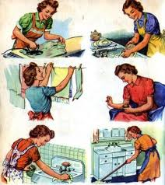
CLEAN
THE
HOUSE

Slide 143
HAVE A BREAK

Slide 144
CLEAN
THE
HOUSE

Slide 145
REST

Slide 146

STUDY

Slide 147
CLEAN
THE
HOUSE

Slide 148
DRINK

Slide 149
STUDY

Slide 150
CLEAN
THE
HOUSE

Slide 151
EAT

Slide 152
STUDY

Slide 153
TALK

Slide 154

COOK

Slide 155
EAT

Slide 156
REST

Slide 157
CLEAN
THE
HOUSE

Slide 158
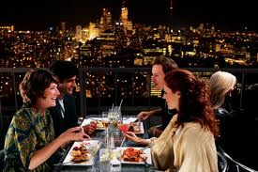
HAVE DINNER

Slide 159
CLEAN
THE
HOUSE

Slide 160
COOK

Slide 161
DRINK

Slide 162
HAVE DINNER

Slide 163
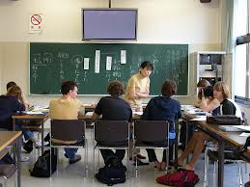
HAVE CLASS

Slide 164
HAVE DINNER

Slide 165
HAVE CLASS

Slide 166

DATE

Slide 167
STUDY

Slide 168
DATE

Slide 169
GO TO WORK

Slide 170
STUDY

Slide 171
REST

Slide 172
COOK

Slide 173
DATE

Slide 174
USE THE COMPUTER

Slide 175
STUDY

Slide 176
EAT

Slide 177
PLAY SOCCER

Slide 178
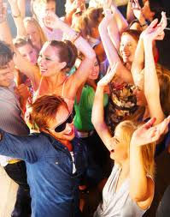
GO OUT

Slide 179
STUDY

Slide 180
HAVE CLASS

Slide 181
HAVE DINNER

Slide 182
DATE

Slide 183
CLEAN
THE
HOUSE

Slide 184
MEET FRIENDS

Slide 185
HAVE CLASS

Slide 186
DRINK

Slide 187
GO OUT

Slide 188
USE THE COMPUTER

Slide 189
STUDY

Slide 190
DATE

Slide 191
HAVE DINNER

Slide 192
HAVE CLASS

Slide 193
GO TO WORK

Slide 194
CLEAN
THE
HOUSE

Slide 195
COOK

Slide 196
GO OUT

Slide 197
STUDY

Slide 198
REST

Slide 199
HAVE A BREAK

Slide 200
DATE

Slide 201
GO OUT

Slide 202
HAVE DINNER

Slide 203

READ

Slide 204
PLAY SOCCER

Slide 205
READ

Slide 206
TALK

Slide 207
GO OUT

Slide 208
READ

Slide 209

LISTEN TO MUSIC

Slide 210
READ

Slide 211
LISTEN TO MUSIC

Slide 212
CLEAN
THE
HOUSE

Slide 213
HAVE LUNCH

Slide 214
GO OUT

Slide 215
LISTEN TO MUSIC

Slide 216
STUDY

Slide 217
PLAY SOCCER

Slide 218
TALK

Slide 219
MEET FRIENDS

Slide 220
READ

Slide 221
HAVE LUNCH

Slide 222
GO OUT

Slide 223
HAVE CLASS

Slide 224
DATE

Slide 225
CLEAN
THE
HOUSE

Slide 226
WORK

Slide 227
READ

Slide 228
GO OUT

Slide 229
DRINK

Slide 230
LISTEN TO MUSIC

Slide 231
GO TO WORK

Slide 232
USE THE COMPUTER

Slide 233
WAKE UP

Slide 234
LISTEN TO MUSIC

Slide 235
DATE

Slide 236
GO OUT

Slide 237
COOK

Slide 238
HAVE DINNER

Slide 239
READ

Slide 240
DRINK

Slide 241
GET UP

Slide 242
HAVE CLASS

Slide 243
GO OUT

Slide 244
REST

Slide 245
HAVE A BREAK

Slide 246
TAKE A SHOWER

Slide 247
DATE

Slide 248
USE THE COMPUTER

Slide 249
HAVE LUNCH

Slide 250
CLEAN
THE
HOUSE

Slide 251
WORK

Slide 252
COOK

Slide 253
DATE

Slide 254
LISTEN TO MUSIC

Slide 255
HAVE DINNER

Slide 256
HAVE CLASS

Slide 257
BRUSH MY TEETH

Slide 258
LISTEN TO MUSIC

Slide 259
EAT

Slide 260
WORK

Slide 261
HAVE DINNER

Slide 262
BRUSH MY HAIR

Slide 263
DATE

Slide 264
LISTEN TO MUSIC

Slide 265
MEET FRIENDS

Slide 266
EAT

Slide 267
GO TO WORK

Slide 268
HAVE A COFFEE

Slide 269
REST

Slide 270
HAVE BREAKFAST

Slide 271
USE THE COMPUTER

Slide 272
READ

Slide 273
COOK

Slide 274
HAVE A BREAK

Slide 275
HAVE DINNER

Slide 276
EAT

Slide 277
DATE

Slide 278
REST

Slide 279
LISTEN TO MUSIC

Slide 280
PLAY SOCCER

Slide 281
READ

Slide 282
CLEAN
THE
HOUSE

Slide 283
DATE

Slide 284
REST

Slide 285
TALK

Slide 286
LISTEN TO MUSIC

Slide 287
COOK

Slide 288
TAKE THE BUS

Slide 289
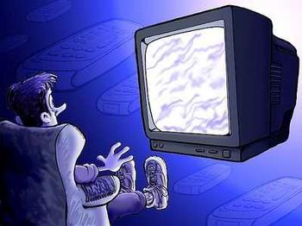
WATCH TV

Slide 290
HAVE CLASS

Slide 291
WATCH TV

Slide 292
LISTEN TO MUSIC

Slide 293
HAVE DINNER

Slide 294
WATCH TV

Slide 295
EAT

Slide 296
WATCH TV

Slide 297
READ

Slide 298
GO OUT

Slide 299
PLAY SOCCER

Slide 300
HAVE CLASS

Slide 301
WATCH TV

Slide 302
COOK

Slide 303
DATE

Slide 304
GO OUT

Slide 305
LISTEN TO MUSIC

Slide 306
HAVE A BREAK

Slide 307
HAVE DINNER

Slide 308
USE THE COMPUTER

Slide 309
EAT

Slide 310
HAVE DINNER

Slide 311
CLEAN
THE
HOUSE

Slide 312
LISTEN TO MUSIC

Slide 313
TALK

Slide 314
WATCH TV

Slide 315
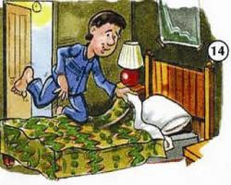
GO TO BED

Slide 316
PLAY SOCCER

Slide 317
COOK

Slide 318
GO TO BED

Slide 319
WATCH TV

Slide 320
GO OUT

Slide 321
DATE

Slide 322
HAVE CLASS

Slide 323
READ

Slide 324
WATCH TV

Slide 325
LISTEN TO MUSIC

Slide 326
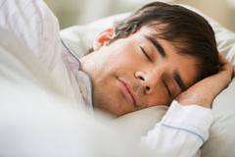
SLEEP

Slide 327
DATE

Slide 328
READ

Slide 329
GO TO BED

Slide 330
USE THE COMPUTER

Slide 331
COOK

Slide 332
WATCH TV

Slide 333
READ

Slide 334
GO TO BED

Slide 335
WATCH TV

Slide 336
LISTEN TO MUSIC

Slide 337
SLEEP

Slide 338
GO TO BED

Slide 339
DATE

Slide 340

DREAM

Slide 341
WATCH TV

Slide 342
READ

Slide 343
SLEEP

Slide 344
DATE

Slide 345
DREAM

